Slide 1
Virtual Med Ed Events Made Easy…
Debbie Martin, Global Account Manager dmartin@incommconferencing.com
201-315-8678

Slide 2
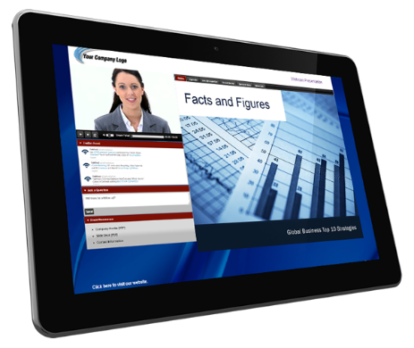
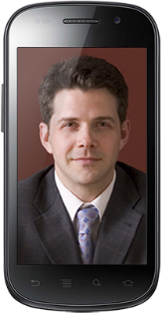
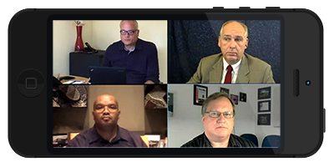
Why Choose InComm?
Two decades of experience supporting medical education, pharmaceutical and IR events
Personalized attention focusing on pre-planning and management
Call Center with state of the art conference bridges and Audio Conference Specialists cross-trained in all aspects of conferencing
Highly skilled Special Services Team available to provide onsite production support
One Stop Shop for Virtual Events led by the InComm Web Support Team

Slide 3
InComm’s One Stop Shop
Virtual Event Experts
Manage and Execute Live and On Demand Events
Produce Post Event Deliverables
Determine Goals and Budget
Research / Recommend Technology Solutions / Create Protocols

Slide 4
Flexible Service Arrangements
Supports Programs on InComm Licensed Products
InComm Web Specialist
Can Support Programs on Client Licensed Products if given ADMIN credentials

Slide 5
Pharma Related Events
Continuing Medical Education
Sales Force Training
Product Launches
Medical & Treatment Updates
Product Marketing Events
Advisory Boards
Speaker Trainings
Interviews

Slide 6
Leverage the Power of a Virtual Venue
Choose a Virtual Venue
Build Brand Recognition: Branded Dial-ins, Custom Music, Custom Web Player Pages
Engage the Audience: Deliver your Presentation, Audio/Web Q/A, Polls, Surveys, Video Clip Roll-ins, Webcams, Live Video Feed, Testing/Certification
Reap Audience Data: Pre-Registration services, Vetting, Detailed Participation Reports
Create Enduring Materials: Recordings, Archives/OnDemand Presentations, Editing Service, Transcriptions

Slide 7
Things to Consider When Planning a Virtual Event

Slide 8
Determining the Right Fit for Your Needs
Web Conference
Small collaborative programs with interactive discussion and participants are typically public to all
Requires Flash enabled or an app connector/download and Audience MUST agree and accept terms/respond to prompts to join
Webcast
Small to large programs where presentation is the focus and Q&A is moderated through Ask A Question text function, and participants are visible to Presenters ONLY.
Browser-based – one click; uses HTML5 for universal entry without download. Hosts/Speaker by VoIP and audience by webcast (phone option)
Best Example: GlobalMeet (Note - Adobe Webinar, and Zoom Webinar Webcasting Products still require an APP/Connector/Download/Install)
Best Examples: WebEx, Zoom and Adobe Web Conferencing Products
Experience highly affected by quality of local internet connection (hosts/speaker and participants by VoIP)
Fully redundant, stable network
Designed to allow Host to change things on the fly with SCREEN SHARE
Designed for a central Administrator (Web Specialist) that manages a program or series of programs. Host role is defined and materials locked down by InComm in a single program repository for review in advance

Slide 9
The Reservation Cycle
Field sends invites to HCPS and establishes an event date/time
Field sends event request with date/time/presenter contact info/duration/#reserved to Med Ed client on established request template
Med Ed client forwards event request template along with meeting assets (PPT) to InComm Web Support for processing. InComm keeps PPT on file for repeated programs in series
InComm returns completed confirmation template with log-in and dial-in info for presenters/participants back to Med Ed client for the upcoming event
Event is executed and InComm sends Post-Conference Attendance Reports to Med Ed client for processing
Med Ed client disseminates confirmation to Field.

Slide 10
The Event Duties of the InComm Web Specialist
Pre-Event
Schedule program; confirmations.
In-Event
Launch program
Post-Event
Generate attendance registration reports
Open program early. Meet & Greet VIPs (host/speaker)
Review call flow with VIPs (COMPLIANCE)
Provide Tech Support
Introduce program and host
Read housekeeping notes to audience
Monitor sound quality
Facilitates electronic Q&A
Closing
Generate detailed “Exception” reports as needed.
Escalate when host or speaker are a “no show”
Check in attendees on the phone and viewers on the web page
Respond promptly to inquiries or issues raised Post-Event and provide assessments along with solutions
Load slide decks and MP4s to room days/weeks in advance for QC by client/presenters.
Apprise audience of speaker/host “schedule” delays
Launch Surveys, Polls as needed
Schedule and conduct a DRY RUN in advance of the event

Slide 11
Comparisons
Wants & Needs | Webcasting (e.g., GlobalMeet) | Web Conferencing
Event Management | Yes – Best suited for central Administrative Access. | Yes – Better suited for Self-Service by Host.
Easy Entry | Yes – Up to Date/ RECENT browser is the only requirement for ANY device (phones, iPads). | No – Downloads, Runs, Installs needed. App store required for mobile device. Pop-ups common.
Detailed Registration | Yes – Robust Data Collection & Reporting | Yes – in some instances, often an upgraded license.
Ability to enforce Compliance Rules | Yes – Defined roles in the program (Admin, Presenters, Audience) with assigned rights. | No – Host has control of the program when sharing a screen and can change slides decks/files, share desktop, share browser on the fly.
Ability for host to easily see everybody in the program. | Yes – Audience participants are anonymous to each other. | Yes – but audience participants may only anonymous to each other on upgraded license. Audience members are never anonymous on webcam.

Slide 12
Comparisons, cont’d
Wants & Needs | Webcasting (e.g., GlobalMeet) | Web Conferencing Web Conferencing (e.g., WebEx, Zoom)
Ability for PPT links to function within program platform | Yes, for actionable links. Not recommended for MP4s. Screen share add-on required for all PPT functioning. | Yes – but Host must shares screen and can change slides decks, share desktop, share browser on the fly (BEWARE).
Display of varying text fonts within a given slide (e.g., bold text not displaying) | Yes, if custom fonts are provided for upload to platform when PPT is built. Slides converted to images. Known issue on occasion with Custom Fonts. | Yes since web conferencing involves screenshare; varying text fonts within a deck will render without issue.
Ability for the speaker to use a webcam | Yes | Yes – Before entry into program, Hosts/Speakers may encounter APPS, Downloads, Runs, Installs needed. App store required for mobile device. Pop-ups common. If Speaker has an Install problem they are NOT getting in.
Ability to use phone or laptop for audio | Yes | Yes - Hosts/Speakers may encounter Downloads, Runs, Installs needed. App store required for mobile device. Pop-ups common. If Speakers have an Install problem, they are NOT getting in.

Slide 13
Comparisons, cont’d
Wants & Needs | Webcasting (e.g., GlobalMeet) | Web Conferencing (e.g., WebEx, Zoom)
Permit Host and other program Collaborators to join Speaker Console via VOIP Bridge (VOIP, Webcam or Phone Access). | Yes – but may there may be different limits per platform or license. | Yes, but control may need to be passed from host to presenter or cohost. Contingencies plans for host drops suggested.
No Special Browser Requirements | Browser must be relatively recent. Only browser reported unsupported is expired and no longer supported by Microsoft. IE versions lower than 11. | If FLASH is not supported, users may be prompted to enable FLASH in their browser before being offered an APP, DOWNLOAD, Runs, Installs. Pop-ups common.
Streamline Sign-In | Yes | Yes, but users may be prompted to enable FLASH in their browser before being offered APP, DOWNLOAD, Runs, Installs, Pop-ups .
Customized Log-In Page/Player Page | Yes | Yes, but depends on license.

Slide 14
VoIP: Proceed with Caution
2-way VoIP is a bad idea with “NO ROOM TO FAIL” programs. Limited by available bandwidth– varies across dispersed audience. You can’t have other applications open and competing for bandwidth – audio will suffer first. # 1 challenge
One click into web program and cost-effective. But can be erratic, jittery, fluctuate and less professional-sounding on occasion
Requires discipline about plugging in good headset; microphone picks up background noise, static and echo
Headphones must be compatible with computer (not earphones). Know where to plug it in and how to do it.
Phone will give you highest level/dependability possible
Millisecond delay in phone; seconds delay in VoIP (jittery)
Challenging for constantly changing, new audiences. Easier to manage small subset of speakers only (InComm will provide test links/ FAQs / need to join early*)

Slide 15
Screen Share: Proceed with Caution
Hosts/Speakers need to develop Virtual fluency on platform and be able to command the audience and the technology, as well as the content of the presentation.
They need to become comfortable with sharing and passing control of their screens.

Slide 16
Don’t Underestimate Ease of Entry:
InComm Webcast Participants NEVER ask
Why is it so hard to join the program?
Should I grant permission to access my computer?
Should I answer “yes” to an install?
Should I call my IT Administrator?

Slide 17
This NEVER happens to an InComm Webcast Participant

Slide 18
This NEVER happens to an InComm Webcast Participant

Slide 19
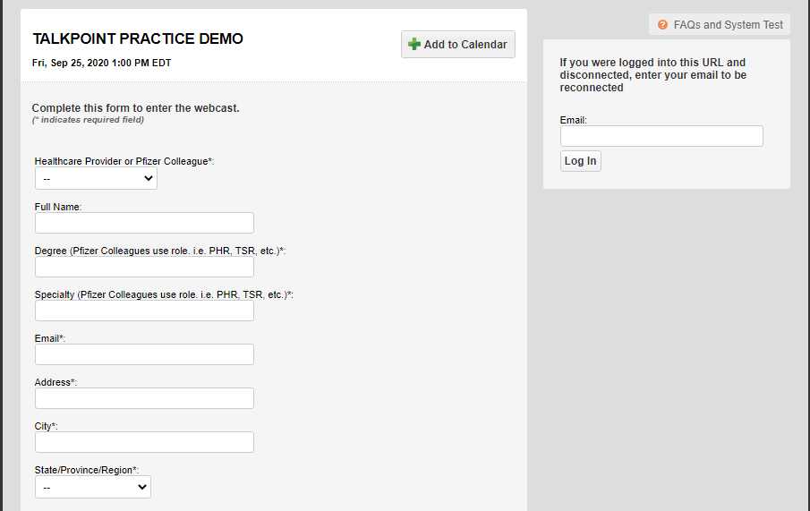
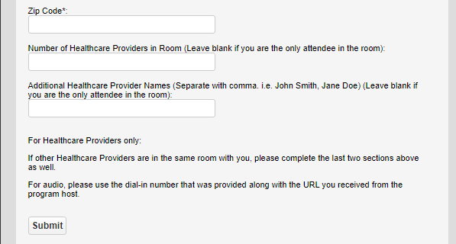
Sample Web Registration

Slide 20
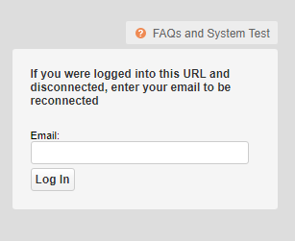
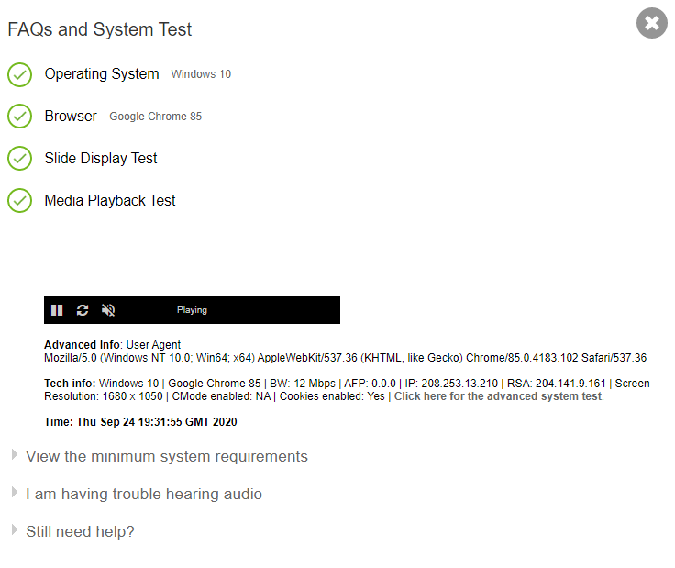
Web Registration – FAQs and System Test

Slide 21
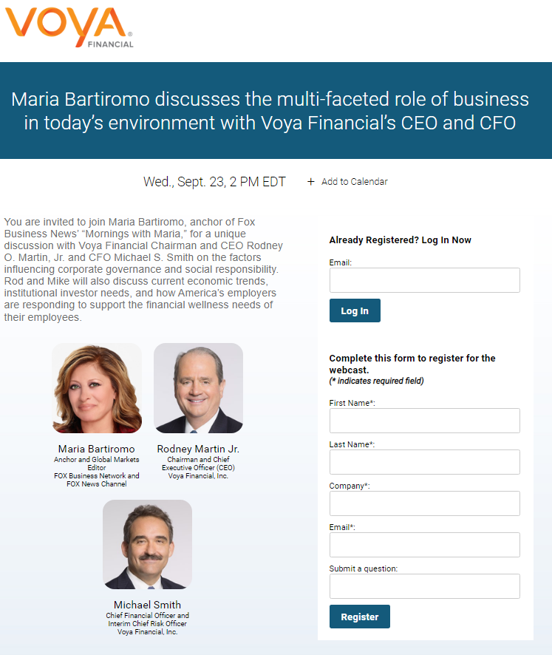
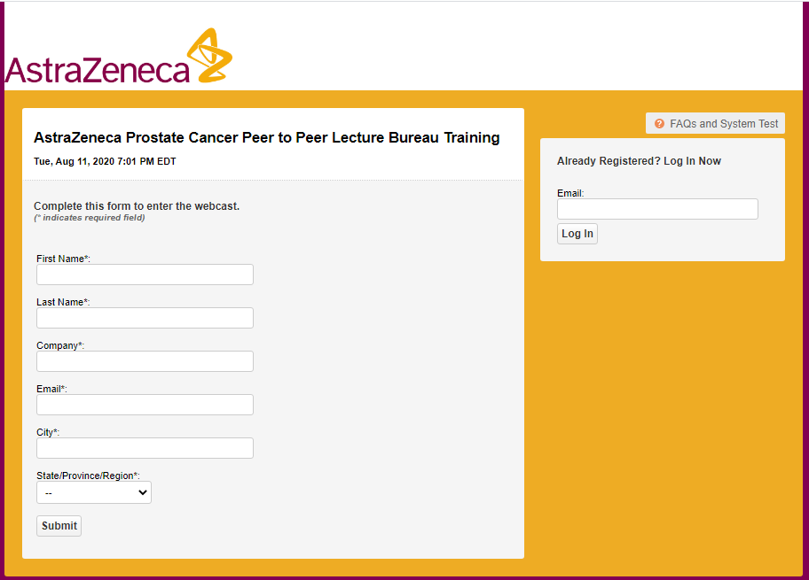
Web Registration Examples

Slide 22
Video Bridge Layout

Slide 23
Let InComm assist you with your next Med Ed program. 20 years of experience will bring you the results that you’re looking for! Debbie Martin dmartin@incommconferencing.com 201-315-8678

